Slide 1
MA2012 Introduction to Mechatronics Systems Design (Circuit 3)
A/P Ang Wei Tech
Email: wtang@ntu.edu.sg
Tel: 6790 4911
Office: N3-01-04

Slide 2
Components
Accelerometer ADXL345
Logic Level Converter
Switches between 3.3V and 5V
Bluetooth Module HC-05

Slide 3
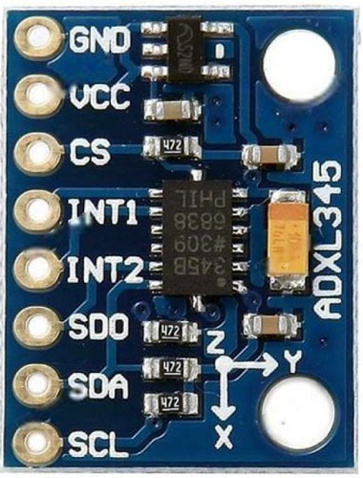
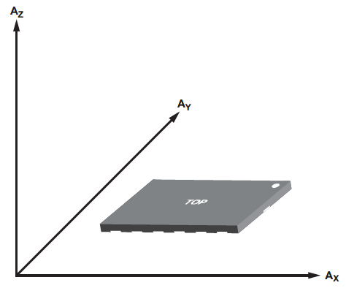
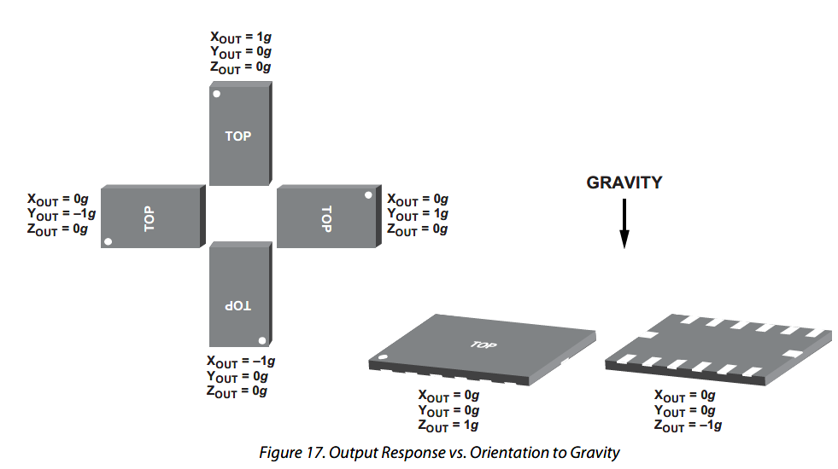
Accelerometer ADXL-345
Measures acceleration in 3 principal axes
Supports SPI and I2C protocols

Slide 4
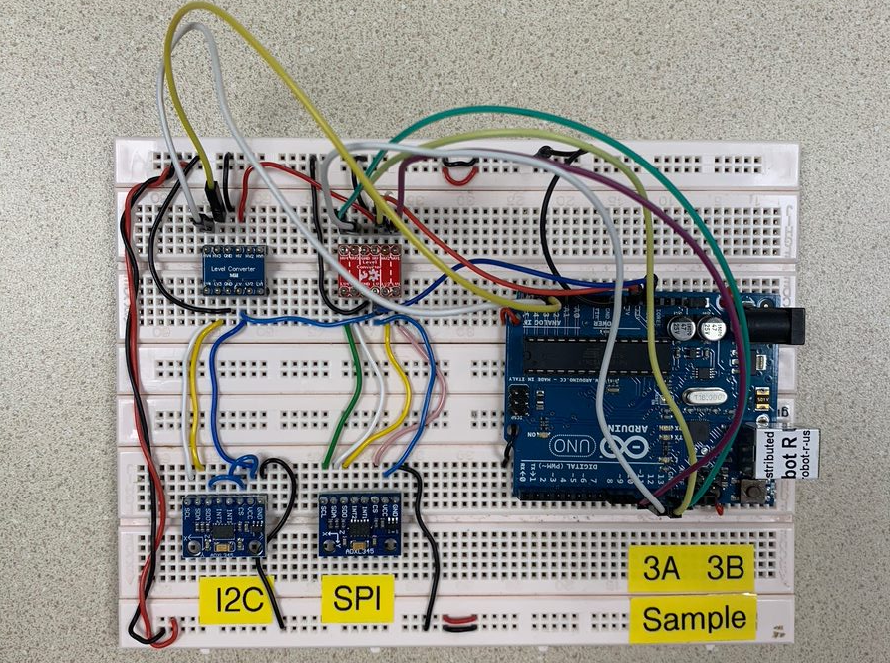
Circuit 3A-SPI & 3B-I2C

Slide 5
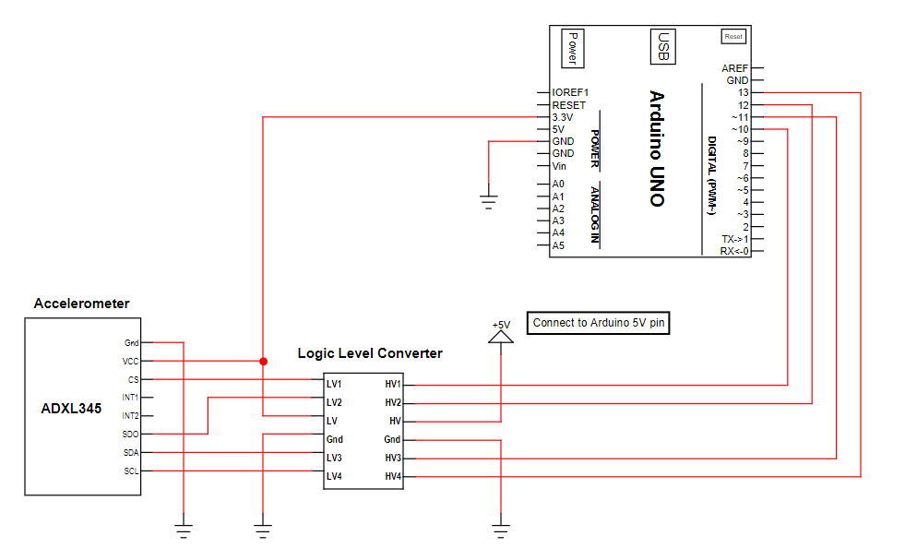
Circuit 3a SPI

Slide 6
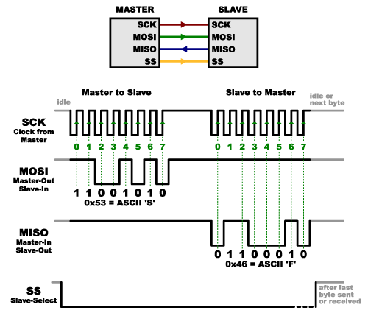
Serial Peripheral Interface (SPI)
Interface bus used to send data between microcontrollers and small peripherals such as shift registers, sensors, and SD cards
3 lines for communication
Shared/Serial Clock (SCK)
Master Out Slave In (MOSI) or Slave Data In (SDI)
Master In Slave Out (MISO) or Slave Data Out (SDO)
1 slave select (SS) line

Slide 7
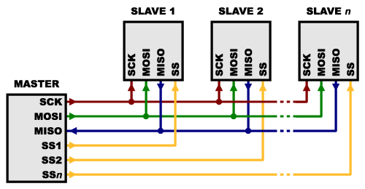
Serial Peripheral Interface (SPI)
1 slave select (SS) line for each slave device
Normally held high to disconnect the slave
Brought to LOW to initiate the communication
Brought to HIGH after communication
Total number of I/O pins required = 3 + n n = number of slave devices

Slide 8
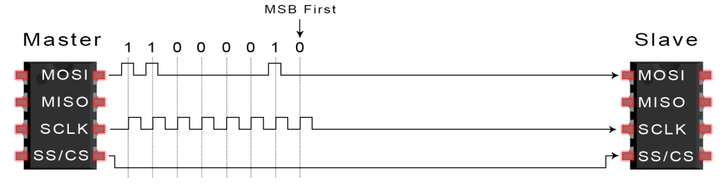
Serial Peripheral Interface (SPI)
Basic process:
Set the SS pin LOW for the targeted slave device
Toggle SCLK (square wave) at a speed ≤ transmission speed supported by the slave device
For each clock cycle, master sends 1 bit on MOSI and receives 1 bit on MISO
Continue until data transmission is complete, and stop toggling the clock line
Set SS pin to HIGH

Slide 9
Serial Peripheral Interface (SPI)
#include <SPI.h>
Arduino Uno:
11 (MOSI)
12 (MISO)
13 (SCK)
10 (SS)
Library Functions
SPISettings(speed,MSB/LSB,mode)
SPI.begin()
SPI.beginTransaction(settings)
SPI.transfer() //read, write

Slide 10
SPISettings(speed,MSB/LSB,mode)
Speed = rated speed of slave
MSB first or LSB first
Mode :
Mode | Clock Polarity (CPOL) | Output Edge | Data Capture
SPI_MODE0 | Low at idle | Falling | Rising
SPI_MODE1 | Low at idle | Rising | Falling
SPI_MODE2 | High at idle | Rising | Falling
SPI_MODE3 | High at idle | Falling | Rising

Slide 11
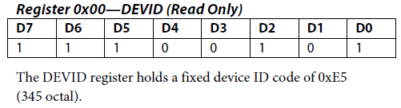
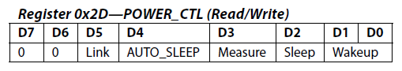
Configuration
Pg15: DEVID(0x00)
Sensor ID
Pg16: POWER_CTL (0x2D)
0b 0000 1000 (0x08)

Slide 12
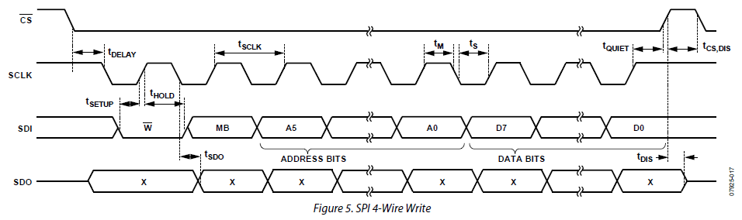
SPI Write
Datasheet pg9
MSB: Write (0)
Followed by 7 bit registry address

Slide 13
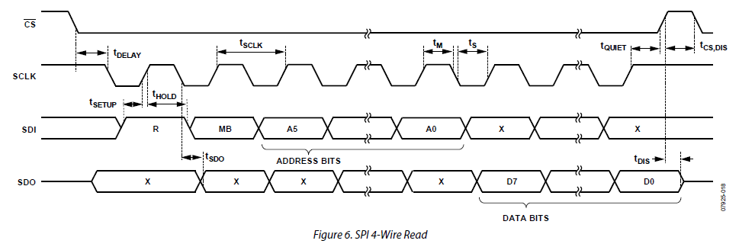
SPI Read
Datasheet pg9
MSB: Read (1)
Followed by 7 bit registry address

Slide 14
SPI Read Example:
Read from DATAX0
Why are sending 0xF2 instead of 0x32?
MSB: 1 = Read, 0 = Write
0b 0011 0010 (0x32): Register Address
0b 1111 0010 (0xF2):
MSB=1 to indicate read
MB=1 to indicate multiple bytes (pg8)

Slide 15
x=SPI.transfer(0) | SPI.transfer(0)<<8;
H | G | F | E | D | C | B | A | 8 | 7 | 6 | 5 | 4 | 3 | 2 | 1
MSB
DATAX : 0x32 to 0x33 (pg18)
0x32
0x33
When reading, 0x32 is send out first
1st read : 0b 8765 4321
2nd read: 0b HGFE DCBA
8 | 7 | 6 | 5 | 4 | 3 | 2 | 1
H | G | F | E | D | C | B | A

Slide 16
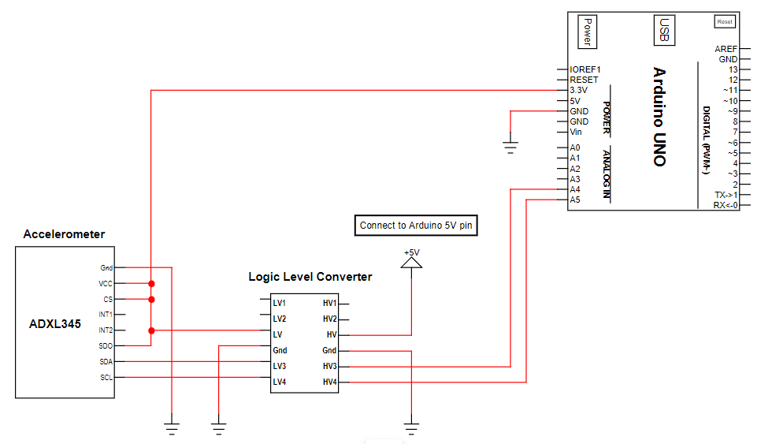
Circuit 3b I2C

Slide 17
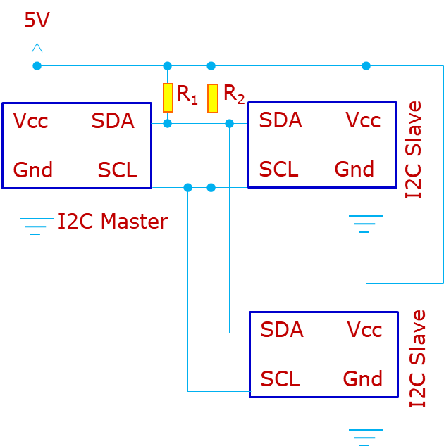
Inter-Integrated Circuit (I2C)
Only 2 signals lines:
Clock signal (SCL)
Data signal (SDA)
Each device must have a unique address
Each signal line requires a pull-up resistor to restore the signal to HIGH when no device set it LOW.

Slide 18
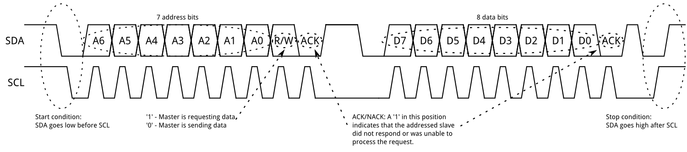
Inter-Integrated Circuit
Basic steps:
Master sends a Start bit
Master sends a 7-bit slave address of intended device
Master sends a Read (1) or Write (0) bit depending on application
Slave responds with an “acknowledge”, i.e. ACK bit (0)
In Write mode, master sends 1 byte of information (command or data) at a time, and slave respond with ACKs. In Read mode, master receives 1 byte of information at a time and sends an ACK to the slave after each byte
When communication has been completed, master sends a Stop bit

Slide 19
Inter-Integrated Circuit (I2C)
Library Functions
Wire.begin()
Wire.beginTransmission(ADR)
Wire.endTransmission()
Wire.write(DATA)
Wire.requestFrom(ADR,byte_size)
Wire.read() //read 1 byte data
#include <Wire.h>
Arduino Uno:
A4 (SDA)
A5 (SCL)

Slide 20
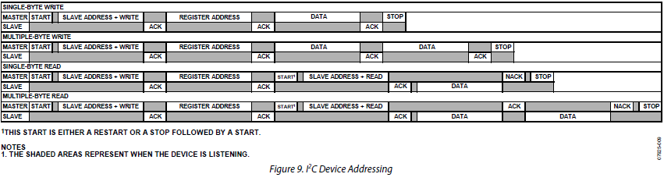
I2C to Accelerometer
Datasheet pg10
Data transferred in 8 bits (MSB first)
Slave Address :
0x1D when SDO/ALT ADDRESS to HIGH
0x53 when SDO/ALT ADDRESS to LOW

Slide 21
I2C Read Data
Datasheet pg18
Acceleration
DATAX0 : 0x32
DATAX1 : 0x33
DATAY0 : 0x34
DATAY1 : 0x35
DATAZ0 : 0x36
DATAZ1 : 0x37

Slide 22
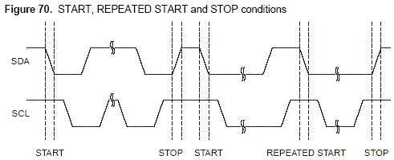
Read Data
Wire.requestFrom(address, quantity)
Wire.requestFrom(address, quantity, stop)
Parameters
address: the 7-bit address of the device to request bytes from
quantity: the number of bytes to request
stop : boolean. true will send a stop message after the request, releasing the bus. false will continually send a repeated start after the request, keeping the connection active.

Slide 23
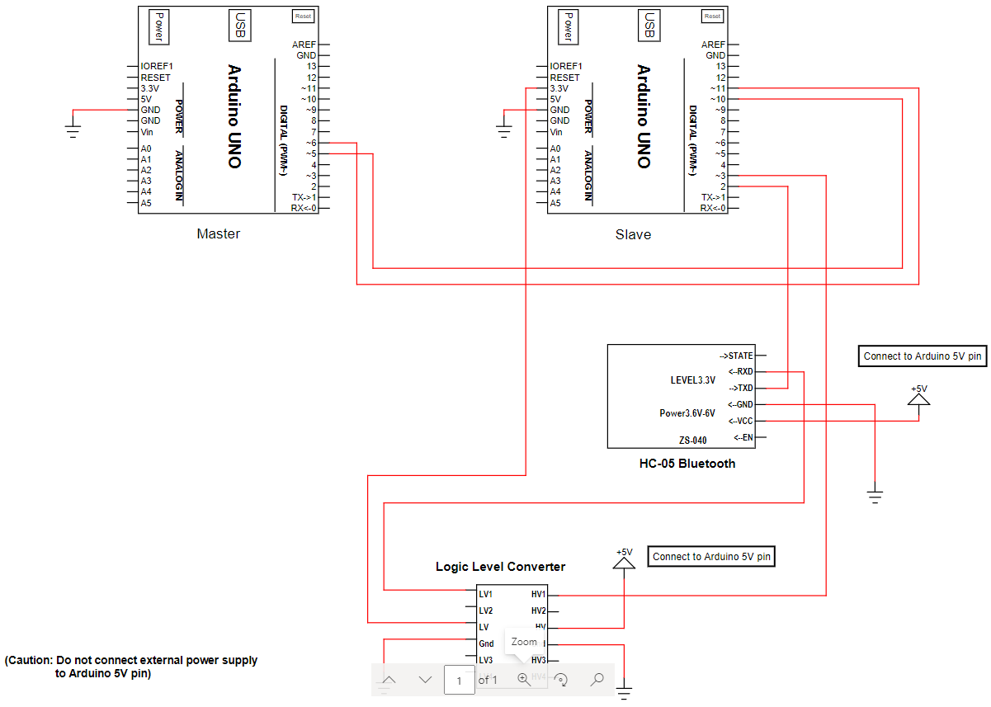
Circuit 3c UART & Bluetooth

Slide 24
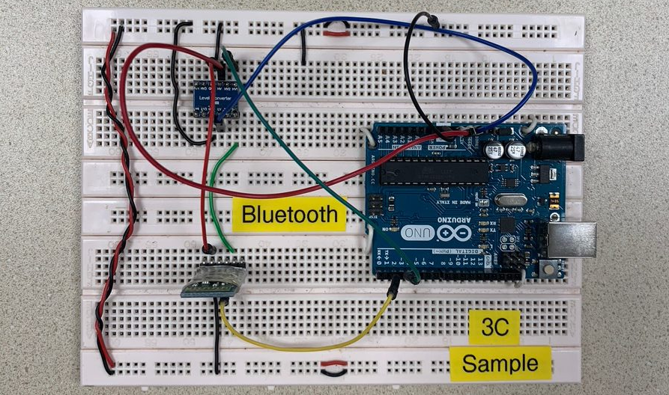
Circuit 3c UART & Bluetooth

Slide 25
Universal Asynchronous Receiver/Transmitter (UART)
One to one Communication
Arduino Uno: 0 (RX), 1(TX) (built in UART)
#include <SoftwareSerial.h>
For use with other digital pins
SoftwareSerial(rxPin, txPin, inverse_logic) | print() , println()
begin(speed) | write() //send as raw bytes
available() | read() //read one byte
listen()

Slide 26
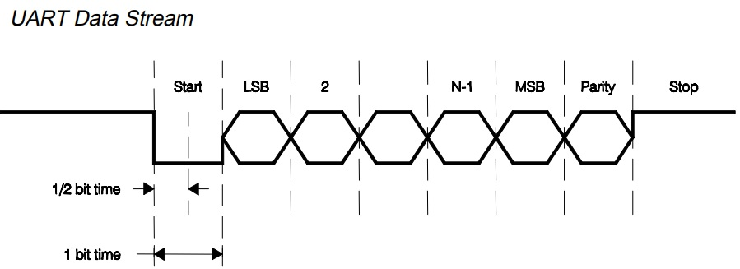
Universal Asynchronous Receiver/Transmitter (UART)
Organise data into packets, each contains:
1 start bit (LOW)
5 – 9 data bits
1 optional parity bit
1 – 2 stop bit (HIGH)
Read data according to baud rate (bit/s)

Slide 27
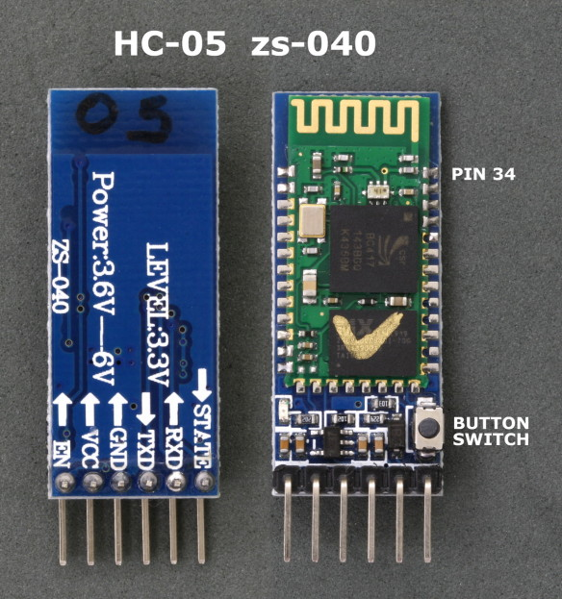
HC-05 (Bluetooth) on zs-040
Use UART to communicate with Arduino

Slide 28
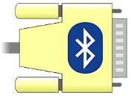

Connect with Bluetooth
Phone Use: “Serial Bluetooth Terminal” from Google Play
PC Use: “Bluetooth Serial Terminal” from Microsoft Store
Connect to your Bluetooth device
Send message

Slide 29
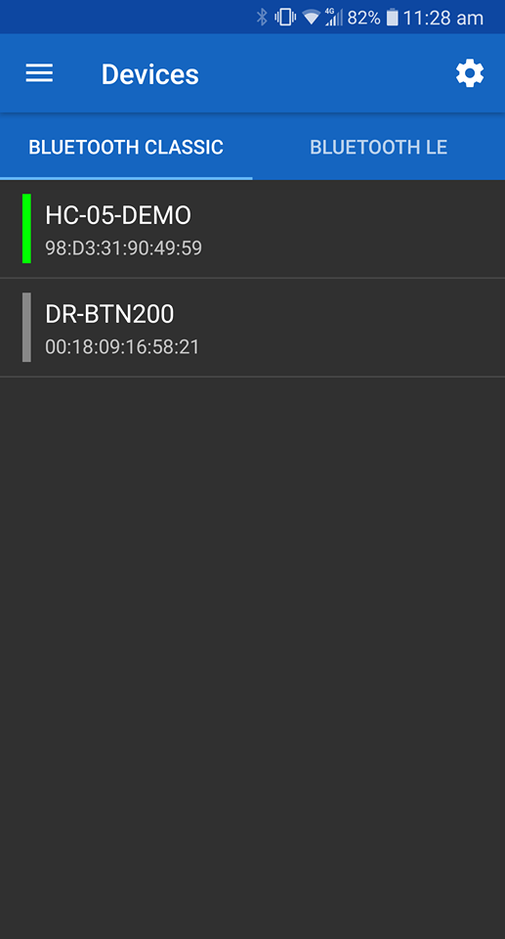
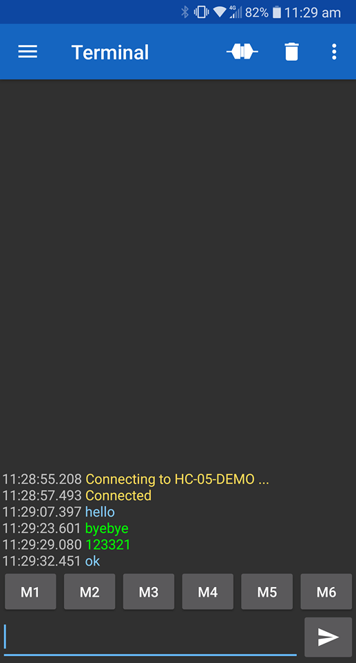
Using Bluetooth with Phone
Click to connect
Select device that you want to connect
Blue text by phone
Green text by Arduino Serial Monitor

Slide 30

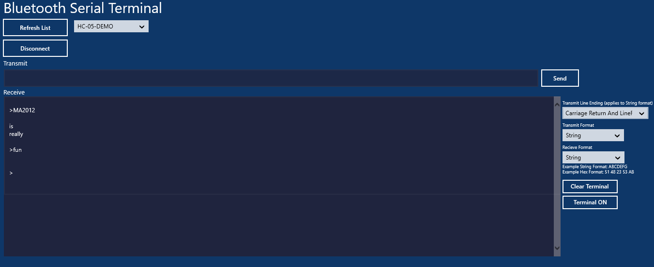
Using Bluetooth with PC

Slide 31
Ex.3-1 Inclinometer
Write a program to perform the following tasks which involves the ADXL345 accelerometer
Using SPI protocol:
If accelerometer is horizontal (tilt <= ± 10°), set the on-board LED to blink
Display “0 degree” on Serial Monitor
If ABS (tilt) > 10°, turn off the LED
Display the tilt angle (to the nearest 0.5 degree) on Serial Monitor, e.g. “15.0 degrees” or “-73.5 degrees”
Repeat using I2C protocol

Slide 32
Ex.3-2 Voltage Matching
Write a program to perform the following tasks:
MCU1:
Connect a potentiometer to one of the unused Analog Input pins
Use Serial communication protocol to transmit voltage output of the potentiometer to MCU2
MCU2:
Use a voltage divider circuit to input 2.5V into one of the unused Analog Input pin
If the voltage value received from MCU1 is 2.5V ± 0.1, set the on-board LED to blink
Use Serial communication protocol to transmit 5 characters to MCU1: “B”, “I”, “N”, “G”, “O”
MCU1:
Use Serial monitor to display the word “BINGO”

